Slide 1
Deconstruct/Reconstruct Project
Fast Food Chains in America
Team 6: Christopher Conlan, Bryan Hannah, Jiao Jiang, Lucio Maestrello
Notes:
Introduction all team member
Describe your theme/topic area and why you choose it

Slide 2
Outline
Data Source/ Original Dashboard
Issues/ Concerns with Dashboard
Deconstruction/Reconstruction
Final Dashboard

Slide 3
What are Dashboards?
Characteristics:
Visualization that conveys meaning from multiple charts/graphs
Often interactive
Tips for Success:
Identify a question to answer
Know your audience
Ensure usability
Provide actionable results

Slide 4
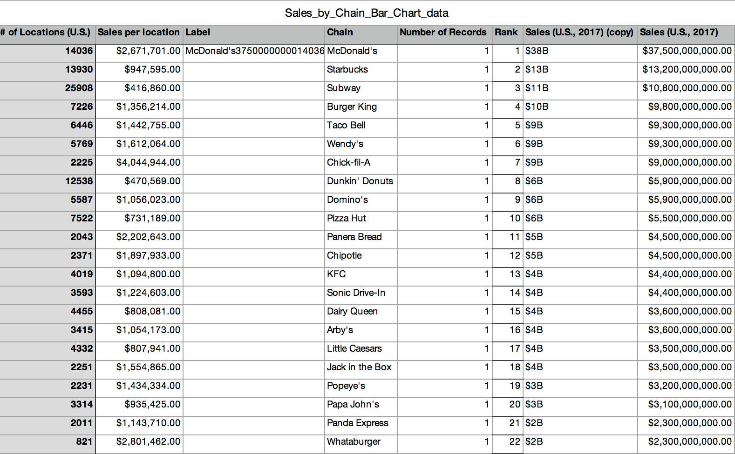
Original Data
Notes:
3. Identify your data source and particular issues or challenges you had with the data

Slide 5
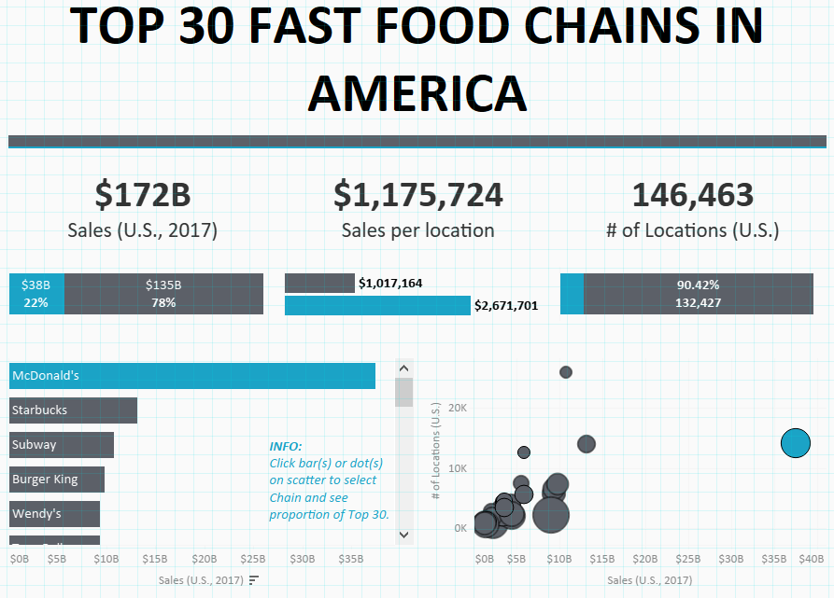
Notes:
Make sure to say this chosen graph is challenging

Slide 6
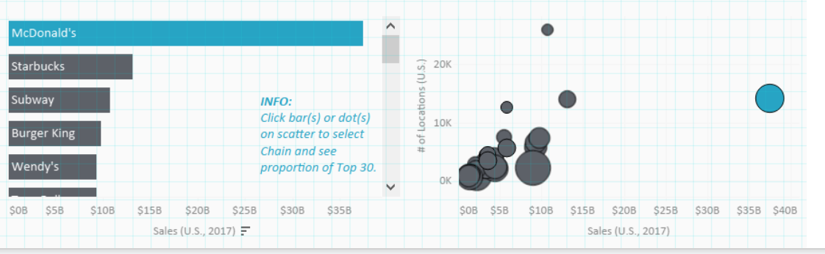
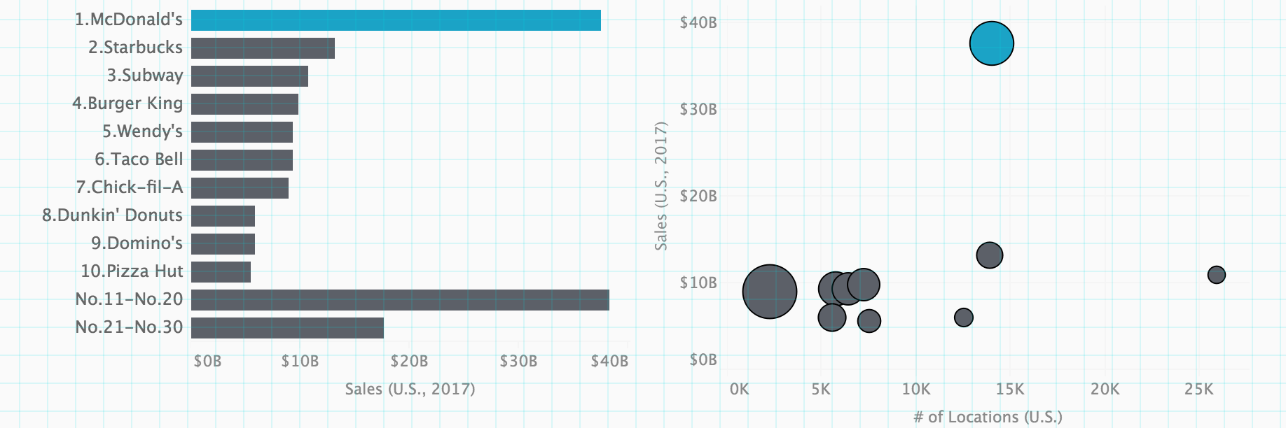
Deconstruction

Slide 7
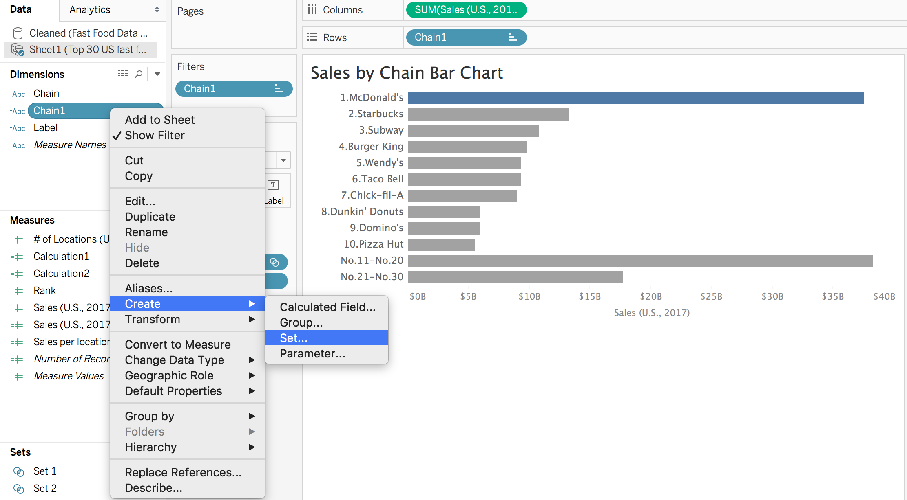
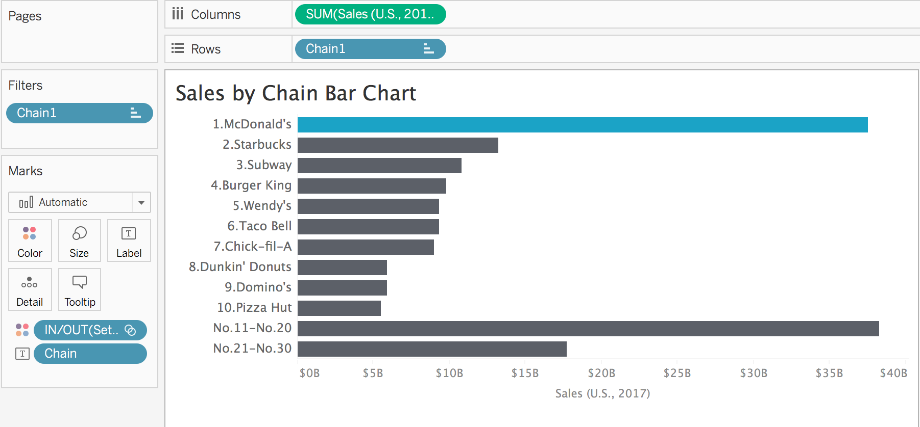
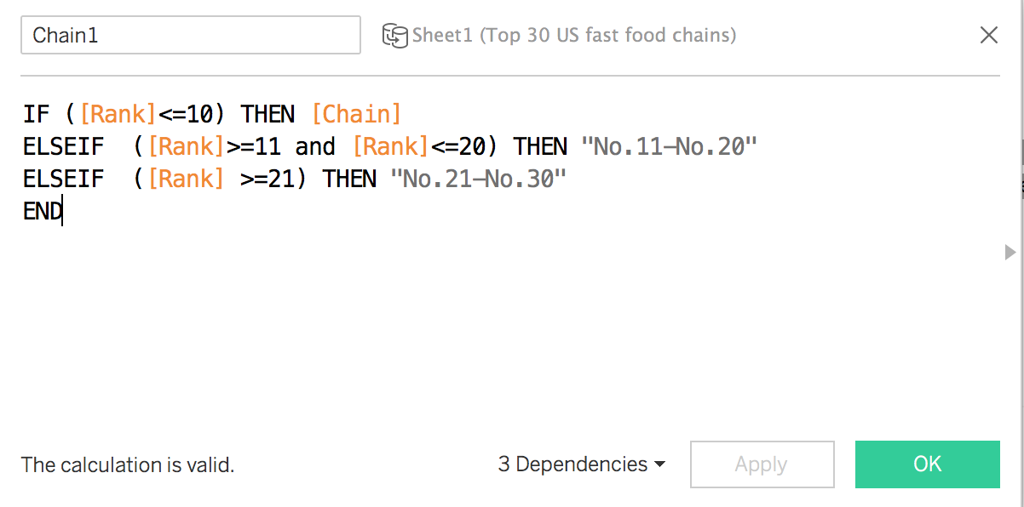
Reconstruction Steps

Slide 8
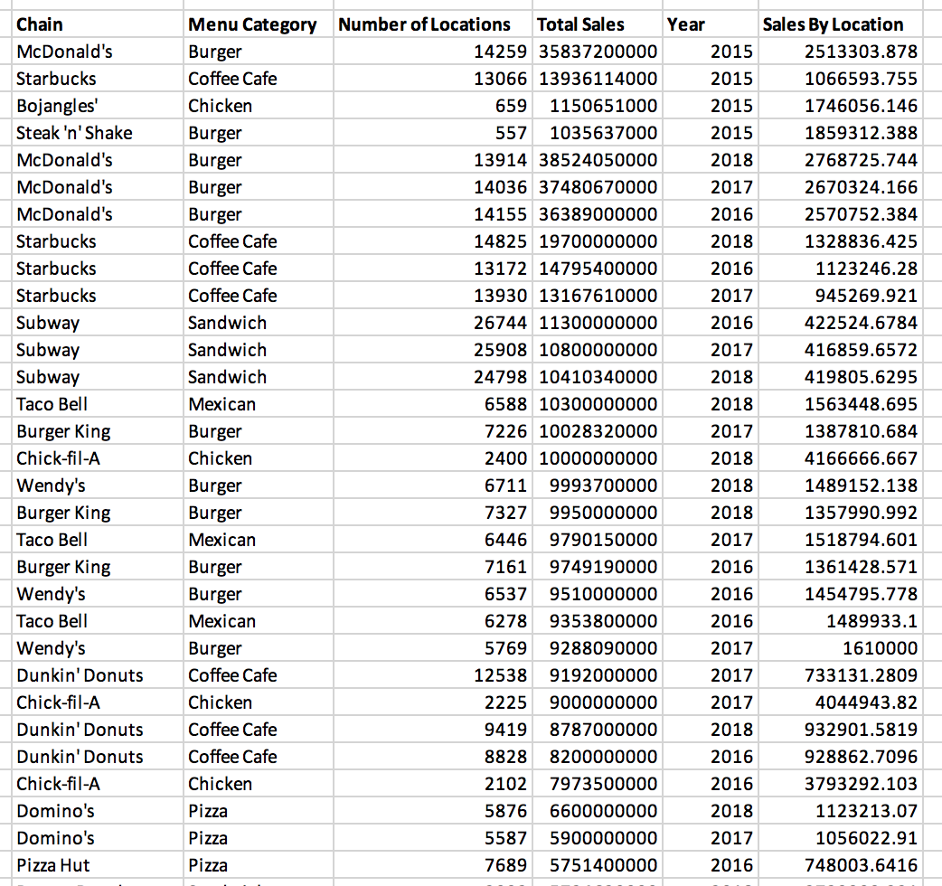
Other Data Sources
Added Menu Category
Added Year 2015, 2016 & 2018
Data Cleaning

Slide 9
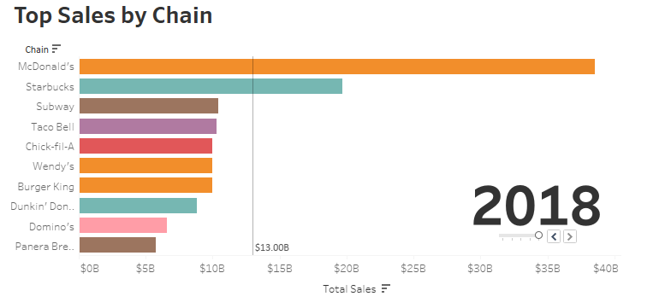
Reconstructed Vis #1

Slide 10
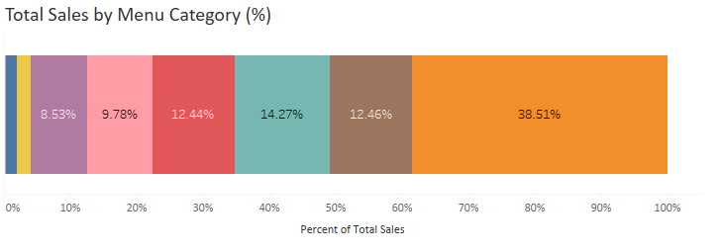
Reconstructed Vis #2

Slide 11
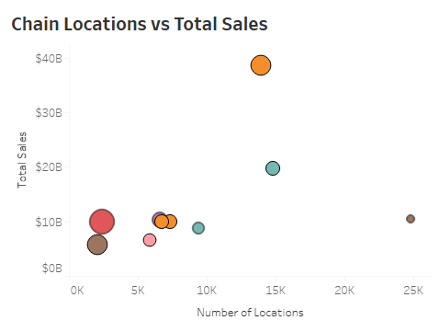
Reconstructed Vis #3

Slide 12
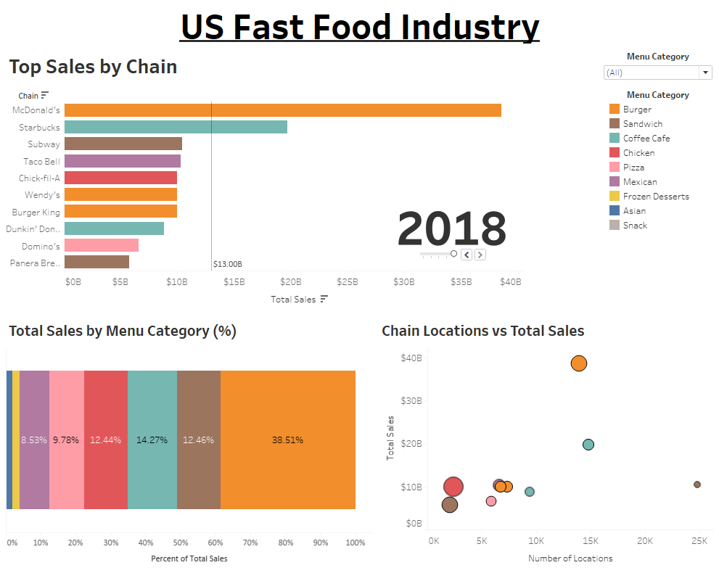

Slide 13


Dashboard Summary
Original Dashboard
Clean
Clear
Concise
Captivating
Recreated Dashboard
Clean
Clear
Concise
Captivating

Slide 14
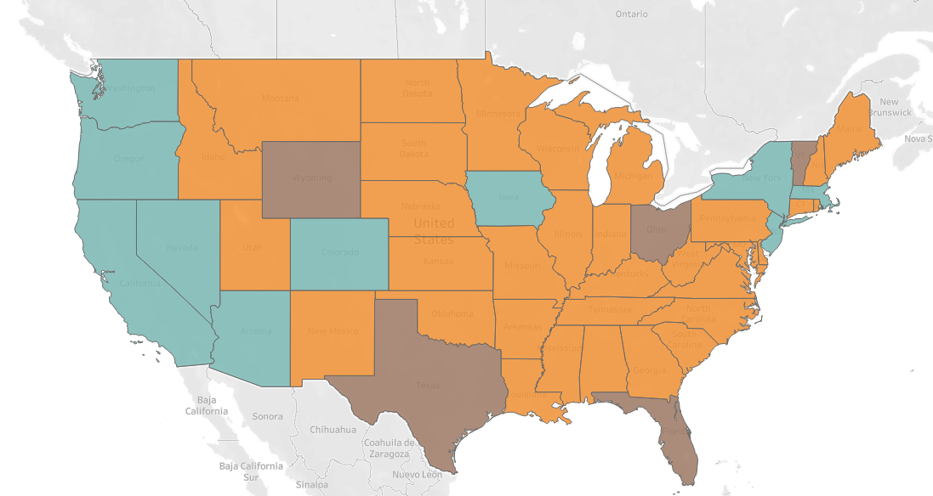
Recommendations
Recommendations:
Invest in top U.S. chain → McDonald’s
Increasing number of locations does not guarantee more sales
What’s Next:
Add location map with top chain in U.S.
Time Series/Forecasting

